Slide 1

Ou comment développer pour Windows... Sans utiliser un seul logiciel propriétaire !
Notes:
Quick intro – 30s
Hello, my name is Aleksey Bragin, I am coordinator of and developer for ReactOS project.
In this talk I’m going to give you a brief overview of ReactOS, components it consists of, technical aspects of the kernel and the bootloader, and perform a small demonstration of what ReactOS really is.

Slide 2

Agenda
1. A propos
2. Présentation de ReactOS
3. Développement pour ReactOS
4. Développement grâce à ReactOS
5. Limites
6. Perspectives
Notes:
All – 30s
Briefly outline the topics which will be discussed
If anyone is unclear on anything please interrupt me, but can you leave any general questions until the end.

Slide 3
Qui suis-je ?
Pierre Schweitzer :
  pierre@reactos.org
  Développeur sur ReactOS depuis Novembre 2007
  Sysadmin sur ReactOS depuis Juillet 2011
  Connu sous les pseudos : Heis Spiter, pschweitzer
Notes:
All – 300 sec
1 - What is ReactOS? – 10 sec
2 – History – 180 sec
Back in the 1970’s and 80’s, the dominant operating system was Unix. However Unix was costly, and out of the reach of your average home user.
In the early 90’s, a computer science student named Linus Torvalds, who was fascinated by hardware and operating systems started a project to rewrite the Unix kernel.
His progress was documented online and quickly aroused the interest of other developers. Development on this free version of Unix grew into what many of you know today as Linux. A dominant presence in the server market, and a potential threat to Windows in the client market.
However, this potential domination in the client market has never really taken hold as the major Linux players continually hope for. Therefore, there is still a huge niche in the market with Microsoft maintaining their stranglehold on end users, at the users cost. This is where ReactOS comes in, with an aim to do with Windows what Linux did with Unix.
ReactOS originally emerged as FreeWin95, encouraged by the growth of Linux, its goal was to write a free implementation of Windows 95. The original project didn’t get very far. There was too much talk about methodologies and not enough coding and it eventually withered away.
In 1997, one of the FreeWin95 developers put out a call out to regroup with a new goal of Windows NT, and an emphasis on writing code as opposed to emails. A new name was decided upon as a reaction to the Windows domination, and ReactOS was born.
The initial years were painfully slow. Low level coding of the kernel mode components was left to specialist developers. With no eye-candy to show to the world, the project remained relatively unknown making it difficult to attract new developers. Initial foundations for the NT kernel and HAL were put in place, and basic generic drivers were written, paving the way for the beginnings of a new operating system.
3 – Complete Windows replacement – 20 sec
ReactOS is an effort to produce a complete rewrite of the Windows NT5 operating system. Thus, ReactOS is not Linux based, but a completely new operating system.
The whole operating system is being written from the ground up, with the entire architecture simulating the NT5 architecture.
We believe most home users are so used to Windows and have become so reliant on it, that a move to a completely different operating system is simply out of the question. There is also the fact that the majority of home users simply don’t have the necessary computer skills to run Linux, or a desire to learn it.
Whilst Linux only provides a kernel with all the other components available as add-ons, ReactOS is a full operating system distribution as Windows is. This means it will not only include system architecture above the kernel, but also apps such as Explorer, Notepad and a paint package.
4 - 100% compatible with Windows – 20 sec
The aim of ReactOS is to take any Windows software off the shelf, and have it successfully install and run in ReactOS. This doesn’t just apply to software such as MS Office or Photoshop, but also applies to games and even drivers.
5 – Licensed under the GPL – 20 sec
The majority of the ReactOS codebase is licensed under the GPL. This means the full source code is available online, and freely available for anyone to download and modify at their leisure. Some parts of the source which have been incorporated from projects such as Wine or BSD are licensed according to their project.
6 – ~20 active developers – 20 sec
Our central code repository is located in Russia and is controlled via a CVS system called SVN. We have active developers from Europe, America and Canada working on ReactOS, and a strong list of contributors from all around the world.
7 – Freely available to everyone – 20 sec
Being that ReactOS is licensed under the GPL, it ensures it will always be freely available, both as in speech, and as in beer.

Slide 4
ReactOS, késako ?
Système d'exploitation libre et gratuit
  http://www.reactos.org
Réimplémentant l'API Windows
  Compatible Windows 2003
Actuellement en version 0.3.15
Toujours en version alpha
Notes:
All – 240 sec
Let's take a look at the key system components that make up its architecture.
A simplified version of this architecture is shown, keep in mind that this diagram is basic, it doesn't show everything. (For example, the networking components and the various types of device driver layering are not shown.)
The four basic types of user-mode processes are described as follows:
Fixed system support processes such as the logon process and the session manager, that are not Windows services. (That is, they are not started by the service control manager)
Service processes that host Windows services, such as the Task Scheduler and Spooler services. Services generally have the requirement that they run independently of user logons. Many Windows server applications, such as Microsoft SQL Server and Microsoft Exchange Server, also include components that run as services.
User applications, dealing with 32 only at present with ReactOS
Environment subsystem server processes, which implement part of the support for the operating system environment, or personality presented to the user and programmer. Windows NT originally shipped with three environment subsystems: Windows, POSIX, and OS/2. OS/2 was dropped as of Windows 2000. As of Windows XP, only the Windows subsystem is shipped in the base product—an enhanced POSIX subsystem is available as part of the free Services for Unix product.
Notice the "Subsystem DLLs" box below the "Service processes" and "User applications" boxes. Under Windows, user applications don't call the native Windows operating system services directly; rather, they go through one or more dlls. The role of the subsystem DLLs is to translate a documented function into the appropriate internal (and generally undocumented) Windows system service calls. This translation might or might not involve sending a message to the environment subsystem process that is serving the user application.
The kernel-mode components of Windows include the following:
The Windows executive contains the base operating system services, such as memory management, process and thread management, security, I/O, networking, and interprocess communication.
The Windows kernel consists of low-level operating system functions, such as thread scheduling, interrupt and exception dispatching, and multiprocessor synchronization. It also provides a set of routines and basic objects that the rest of the executive uses to implement higher-level constructs.
Device drivers include both hardware device drivers that translate user I/O function calls into specific hardware device I/O requests as well as file system and network drivers.
The HAL is a layer of code that isolates the kernel, device drivers, and the rest of the Windows executive from platform-specific hardware differences (such as differences between motherboards).
The windowing and graphics system implements the graphical user interface (GUI) functions (better known as the Windows USER and GDI functions), such as dealing with windows, user interface controls, and drawing.

Slide 5
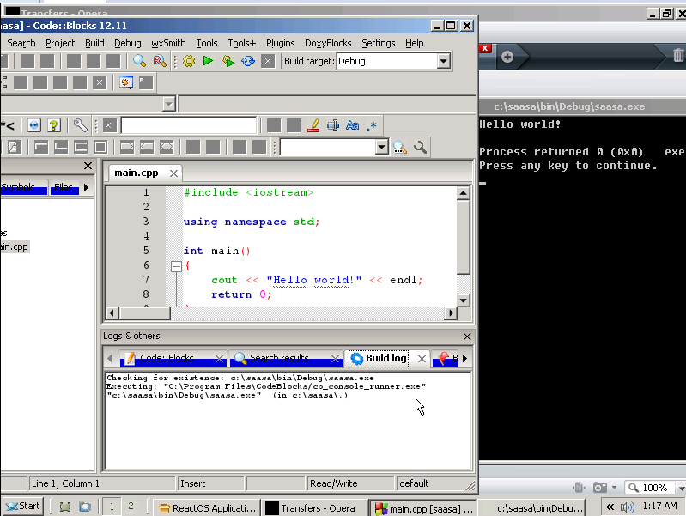
En image
Notes:
All – 20 sec
Ok, I’m gonna move away from the architecture design, and speak about key components which the majority of people are interested in, and the state of these components in ReactOS.
Executive, including HAL, Kernel and device drivers
Win32 subsystem, comprising of both kernel and usermode components
The network model, from layer 2 to layer 7
GDI, windowing and the user interface
Gaming, provided by both DirectX and OpenGL.

Slide 6
Colloration avec le monde du libre
Utilisation de code Wine
Chaîne de (cross-)compilation de MinGW-w64
Mais aussi de CMake, ninja, etc

Slide 7
Collaboration avec Wine
Récupération de leurs DLLs
Mais aussi des outils de compilation
Récupération de leurs tests
En contrepartie, envoie de patches/fixes

Slide 8
ReactOS n'est pas Wine
Implémentation d'un noyau
Implémentation de pilotes
Support des pilotes Windows
Pas besoin de Linux

Slide 9
Développement sous ReactOS
ReactOS Build Environment (RosBE)
Chaîne de compilation complète
GCC, ninja, Cmake, etc
Tourne Linux, BSD, MacOSX...
… Et Windows !
Notes:
Say the most important modules of the kernel, not all

Slide 10
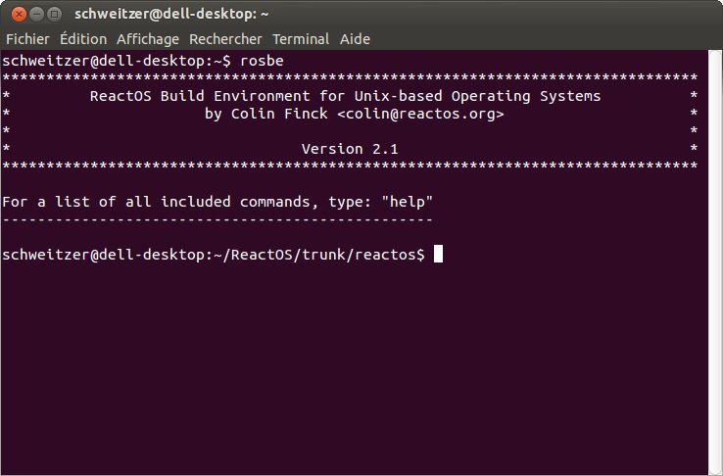
RosBE en image

Slide 11
Prérequis pour développer
Installation du RosBE
Checkout du code de ReactOS (svn)
Nécessaire pour les entêtes et les bibliothèques

Slide 12
Développement d'applications
Utilisation des DLLs Windows
Via leur implémentation dans ReactOS
Compilation grâce au RosBE
Fonctionnelle sous Windows et ReactOS
Notes:
All – 120 sec
The ReactOS HAL is incompatible with the Windows equivalent, although some work has recently been done to make it more compatible regarding calls into the kernel. It has a minimal set of APIs which drivers use to communicate with hardware which are compatible (like read/write to ports, delay execution, etc)
however, higher stuff like initialization, apic/pic support / irq handling, video init/deinit, is quite different from windows.
Discuss kernel compatability
Process Support…
Object Manager…
Kernel…
IO Manager…
Executive…
RunTime lib…
Security…
Memory Manager…
FileSystem Manager
Power Manager…
Cache Controller…
Kernel debugger + usermode debug APIs
ReactOS drivers are similar to windows versions and uses the same mechanisms (i.e. a IRP which is passed from driver to driver in the device driver stack) so we can currently support (a few) XP windows drivers (except storage stack which still uses the NT4 format)
Basics are now in place to run all XP drivers, you can install drivers with the wizard, and driver will run if it doesn't use unimplemented/buggy functions in ntoskrnl and if it doesn't use WMI as it’s not implemented yet.
The pnpmgr pretty much feature complete. It will detect the addition of new hardware and popup the install wizard, whereby you can install drivers by pointing them at the .inf file. However, it currently doesn't support the removal of a device.

Slide 13
Dans la pratique (simplement)
Ajout des fichiers sources dans un répertoire
Écriture d'un fichier CmakeFiles
Ajout du répertoire dans l'arborescence ReactOS
$ ninja application

Slide 14
Exemples ?
Les applications de ReactOS
  Qui fonctionnent aussi sous Windows
Les pilotes de ReactOS
  Qui fonctionnent globalement sous Windows
Les applications 3rd parties, inclues dans ReactOS
  Et compilées via le RosBE

Slide 15
Bémols
Toutes les APIs ne sont pas implémentées
L'application peut marcher sous Windows....
… Et beaucoup moins sous ReactOS

Slide 16
Attention au C++...
G++ compatible Itanium C++ (id. LLVM)
MSVC (Windows) compatible avec lui-même
Soucis lors de la compilation vers API C++
Workaround grâce à des bibliothèques d'alias

Slide 17
Quid des autres languages ?
Certains compilateurs de BASIC sont supportés
Java avec un support partiel
Mono (.NET) avec un support partiel
Pas dans la chaîne de compilation, dans ReactOS lui-même

Slide 18
RosBE dans ReactOS
Ne fonctionne pas encore complètement
Objectif important : ReactOS compile ReactOS
Objectif secondaire : ReactOS héberge ReactOS

Slide 19
Conclusions
ReactOS
  Système d'exploitation compatible Windows
Offre des possibilités de cross-compiler des applications
  Uniquement besoin du RosBE
  Du code de ReactOS
  Et de l'application
  Uniquement des logiciels libres
Limites en raison du statut « alpha »

Slide 20
Merci pour votre attention !
Des questions ?
Notes:
Question time!
A demonstration of ReactOS!

